Slide 1

Windows CE System
3. Platform Development
School of software Engineering
2004

Slide 2
Agenda
Introduction to Platform Builder
  User Interface
  Catalog and Feature
  Platform Configuration
Platform Creation workflow
The Build System
Catalog Customization

Slide 3
Agenda
Introduction to Platform Builder
  User Interface
  Catalog and Feature
  Platform Configuration
Platform Creation workflow
The Build System
Catalog Customization

Slide 4
Introduction to Platform Builder
An integrated development environment (IDE) for building customized embedded platforms based on the Microsoft Windows CE operating system (OS).
Comes with all the development tools necessary for you to design, create, build, test, and debug a Windows CE–based platform.
The IDE provides a single integrated workspace in which you can work on both platforms and projects.

Slide 5
What can PB do? (1)
The New Platform Wizard assists in creating a new platform.
The BSP Wizard streamlines the process of creating a board support package (BSP).
The Catalog displays a list of OS features that can be used to customize a platform.
Automated dependency checking ensures all features required to support a platform configuration are included in the OS image.
The Export Wizard exports custom Catalog features to other Platform Builder users.
Base configurations provide starting points for creating custom OSs.

Slide 6
What can PB do? (2)
The Windows CE Test Kit provides a collection of driver-testing tools.
The kernel debugger debugs a customized OS image and provides the user with information regarding the performance of that image.
The application debugger debugs applications on a customized OS image.
The remote tools perform a variety of debugging and information gathering tasks on a Windows CE–based target device.
The Emulator speeds and simplifies development by emulating hardware, allowing the user to test platforms and applications on a development workstation.
The Export SDK Wizard enables the user to export a custom software development kit (SDK).

Slide 7
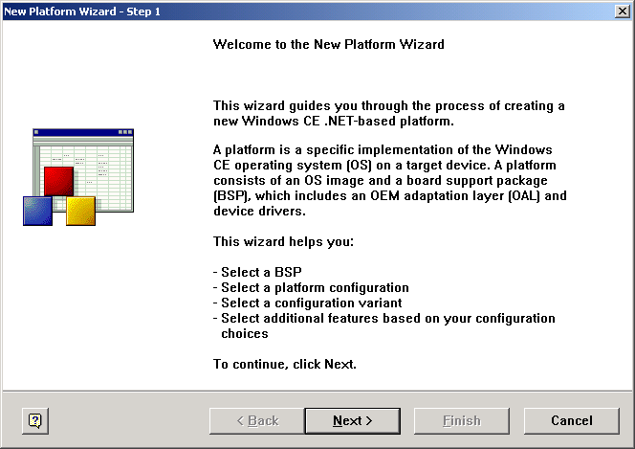
Review of Platform Wizard
The New Platform Wizard guides you through the process of creating a Windows CE–based platform.

Slide 8
Platform Wizard 4 Steps
Selecting an installed board support package (BSP).
Selecting a platform configuration for your device.
Selecting a configuration variant that is appropriate for your device.
Selecting additional features for your platform.

Slide 9
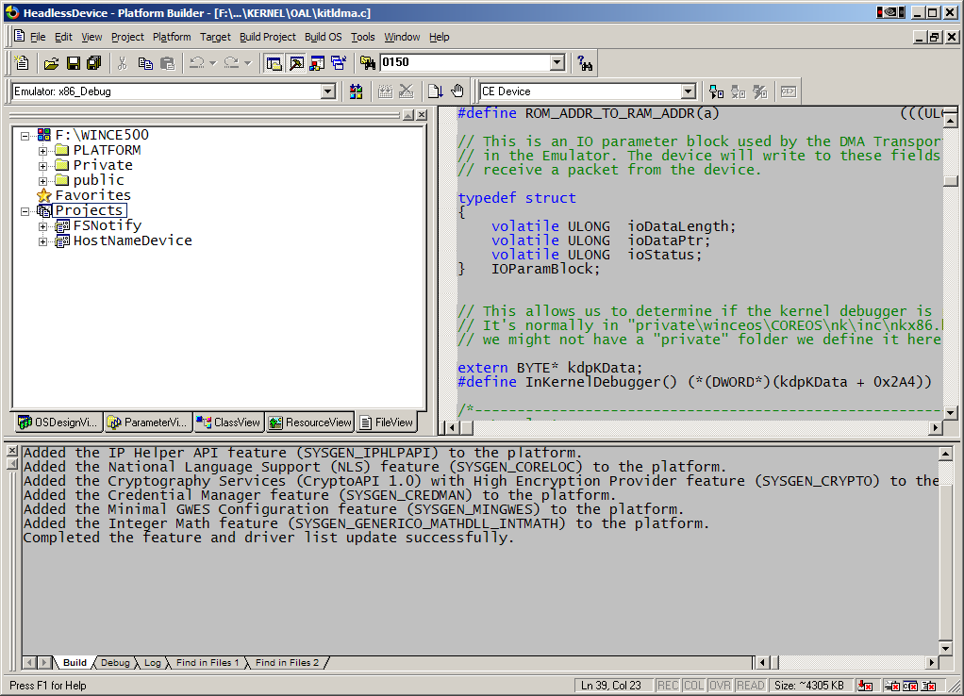
Platform Builder UI
Search Text
Text Editor
Build Configuration
Connectivity Device Name
Workspace Window
Multiple views of the workspace
Output Windows
Debug tool status indicators

Slide 10
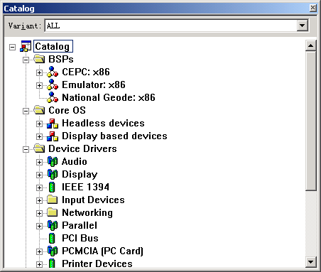
Catalog View
Consists of a list of BSPs, drivers, configurations for core OS, and Platform Manager transports. The items in the Catalog represent ALL the technologies you can select when designing your Microsoft Windows CE based platform.

Slide 11
Catalog organization
Board Support Packages
Core OS: includes headless devices and display-based devices:
  Applications and Services Development
  Applications - End User
  Communication Services and Networking
  Core OS Services
  File Systems and Data Store
  Fonts
  International
  Internet Client Services
  Multimedia Technologies
  Security
  Shell and User Interface
Device Drivers
Platform Manager

Slide 12
Feature Group and Feature
A feature group defines a general type of feature without specifying a specific implementation. A feature group is resolved when you select an implementation and thus specify the functionality.
A feature is any logical grouping of OS components.

Slide 13
Feature Icon Type
Icon | Description
 | BSP
 | Core OS design
 | Catalog item group.
 | Required Catalog item.
 | Optional Catalog item.
 | Catalog item, type, or implementation excluded from the current OS design.
 | Folder
 | Catalog item that has one or more special notifications.
 | Catalog properties for a specific implementation of a Catalog item.
 | Implementation

Slide 14
Feature Icon Type (2)
Icon | Description
 | User-specified Catalog item.
 | Catalog item (optional).
 | Catalog item that can be built but is excluded from the run-time image.
 | Catalog item excluded from the build and the run-time image.
 | Source code file.

Slide 15
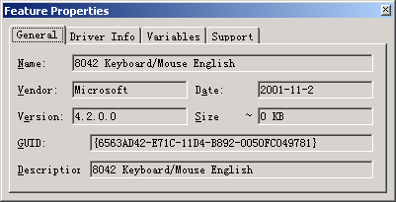
Feature Property
Displays information for the selected feature.

Slide 16
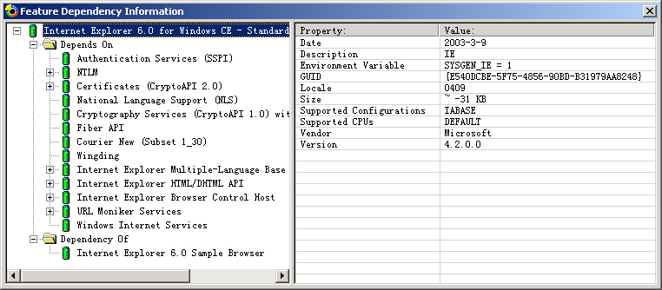
Feature Dependency
Show the dependency of a selected feature

Slide 17
Challenge for Engineer
Know as many features as possible

Slide 18
Challenge for Engineer
Requires your experience and knowledge
Can NOT design required platform without this.
  Can Windows CE has a Chinese IME?
  Does Windows CE support VBScript?
Detailed feature functionality reference at :
  About Windows CE.NET -> Catalog Features

Slide 19
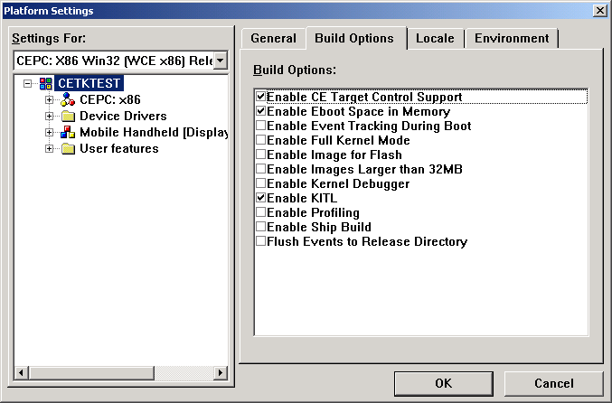
Platform Setting
Enables you to view and modify options for individual features and for an entire platform.
Menu : Platform -> Settings…

Slide 20
Build Options (1)
Enable CE Target Control Support
  Select the Enable CE Target Control Support check box to enable target control support during the boot process. Selecting this also enables Kernel Independent Transport Layer (KITL).
Enable Eboot Space in Memory
  Select Enable Eboot Space in Memory to reserve memory space in the Config.bib file. This allows the boot loader to save data that the operating system (OS) can read at boot time.
Enable Event Tracking during Boot
  Select Enable Event Tracking to start the event-tracking subsystem.
Enable Full Kernel Mode
  Select Enable Full Kernel Mode to run threads in kernel mode. Enabling full kernel mode will leave the entire system vulnerable, but will increase performance.
Enable Image for Flash
  Select the Enable Image for Flash check box to allow the image to be written to flash after download.

Slide 21
Build Options (2)
Enable Kernel Debugger
  Allow the debugger to connect and pass debugging information from the target device to the host device.
Enable KITL
  Select the Enable KITL check box to enable KITL. This should be checked to allow communication between the development workstation and the target device. Deselecting this will also deselect Enable CE Target Control Support if it is selected.
Enable Profiling
  Select the Enable Profiling check box to enable Windows CE log kernel profiling in the platform image.
Enable Ship Build
  This flag can be used to conditionally compile code. If set, the OS will provide verbose debug messages to aid debugging.
Flush Events to Release Directory
  Select the Flush Events to Release Directory check box to flush events to the release directory. Selecting this also turns on Event Tracking.

Slide 22
Platform Configuration Files
Platform Builder uses two general categories of configuration files:
source code configuration files
  The Build tool uses source code configuration files to build modules and features, and to build the source code for your operating system (OS) image.
image configuration files
  The Make Binary Image Tool calls a number of tools, which use image configuration files to create the OS image.

Slide 23
Source code configuration files
File type | Description
Dirs File | Identifies subdirectories that contain source code.
Sources File | Contains the macro variables needed to build source code.
Makefile File | Contains the variables needed to compile and link the source code.

Slide 24
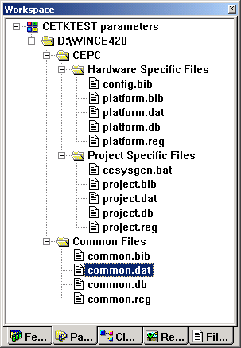
Image Configuration Files
Parameter View

Slide 25
The Configuration Files: .BIB Files
Indicates the modules and components that should be included in the image
Text files with four types of sections:
  The FILES section: Memory reservation for static data files
  The MODULES section: Specifies object module to be loaded in memory
;Name Path Memory Type
-----------------------------------------------------
Tahoma.ttf $(_FLATRELEASEDIR)\Tahoma.ttf NK SHU
Taskman.exe $(_FLATRELEASEDIR)\Taskman.exe NK

Slide 26
The Configuration Files: .BIB Files
MEMORY section
  defines the platform memory information
  Partitions the physical memory into Data memory and Program memory
The CONFIG section
  Is not mandatory
  Is used to set properties, such as compression or ROM size
  Name Start address Size(bytes) Type
  -----------------------------------------------
  NK 8C800000 00800000 RAMIMAGE
  RAM 8C050000 007AFFFF RAM

Slide 27
The Configuration Files: .REG Files
Define default registry settings
  COMMON.REG, IE.REG, WCEAPPS.REG, WCESHELL.REG: define registry settings for Windows CE modules
  PLATFORM.REG: platform-dependent registry settings, such as device drivers entries
  PROJECT.REG: defines registry settings relative to your project
  [HKEY_LOCAL_MACHINE\init]
  “Launch10”=“shell.exe”
  “Launch20”=“device.exe”

Slide 28
The Configuration Files: .DAT Files
Define folder structures of your image
  COMMON.DAT, IE.DAT, WCEAPPS.DAT, WCESHELL.DAT
  PLATFORM.DAT
  PROJECT.DAT
Example:
  Root:-Directory(“Program Files”)
  Directory(“\Program Files”):-Directory(“My Projects”)
  Root:-Directory(“My Documents”)
  Directory(“\My Documents”):-File(“MyFile.doc”,“\
  Windows\Myfile.doc”)

Slide 29
The Configuration Files: .DB Files
Define default image databases
  COMMON.DB, WCEAPPS.DB, WCESHELL.DB
    These .DB files are the databases relative to the Common, Wceapps, and Wceshell modules
  PLATFORM.DB
    The PLATFORM.DB file contains the platform-specific default databases
  PROJECT.DB
    The PROJECT.DB file contains the project-specific default databases

Slide 30
Making an Image
Merges release folder files to make the Windows CE image
Process
  Merge configuration files:
  All .bib files into CE.BIB
  All .reg files into REGINIT.INI
  All .dat files into INITOBJ.DAT
  All .db files into INITDB.INI
  Compress reginit.ini in a binary registry file (DEFAULT.FDF)
  Replace resources in .exe and .dll for language adaptation
  From ce.bib, combine binaries and files into a Windows CE image (NK.BIN)

Slide 31
The Build Phases
when you select the Build Platform command on the Build menu in the IDE, the build system builds a platform in four sequentially executed phases:
Sysgen phase
Feature Build phase
Release Copy phase
Make Image phase

Slide 32
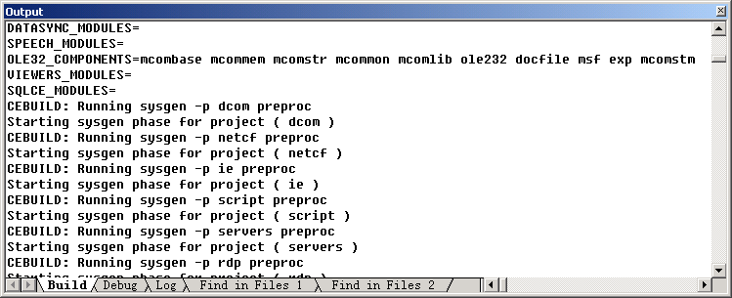
Sysgen phase tasks
Link the corresponding static libraries into modules
Make SDK
  filters the system header files, creating headers that only contain prototypes for the functions exported by your platform.
  Create Import libraries for the system modules
Build the board support package (BSP)

Slide 33
System Generation
Complete header and source code files
System-specific header files
Complete system libraries
SYSGEN.BAT
Linked libraries
Module definitions (.def)
Specific .def files
Cesysgen.bat

Slide 34
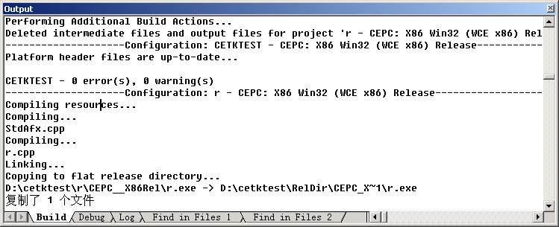
Feature Build phase task
All user features including Platform Builder project (.pbp) files, dirs files, sources files, and makefiles (.mak) files are compiled and built.

Slide 35
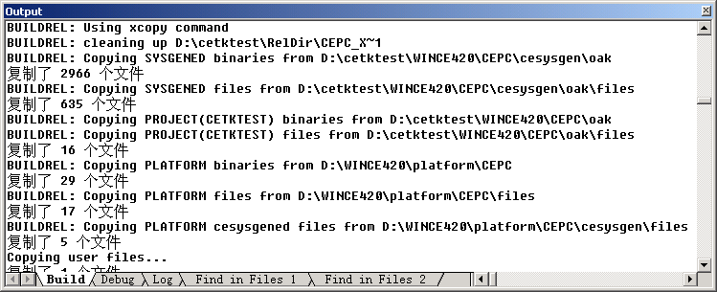
Release Copy phase task
Copy all the files you need to make an OS image to the release directory. The modules and files created during the Sysgen phase are copied to this directory first, followed by the files created by the Feature Build phase.

Slide 36
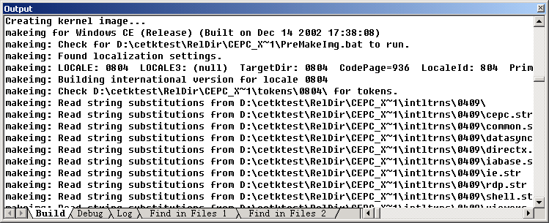
Make Image phase task
The files in the release directory are combined in the binary image file Nk.bin.
This phase corresponds to the Make Image command on the Build menu.

Slide 37
The Build Process
COMMON
DATASYNC
DCOM
DIRECTX
IE
RDP
SCRIPT
SERVERS
WCEAPPSFE
WCESHELLFE
…
..\cesysgen\ddk
..\cesysgen\oak
..\cesysgen\sdk
\target, \files
Step 1. System Generation
Step 2. Build
..\platform\..
\target, \files
Step 3. Building the Release Directory
%_FLATRELEASEDIR%
Step 4. Making an Image
NK.BIN

Slide 38
Build Result
nk.bin :
  Windows CE binary image data format
  when executed, must loaded into memory first.
  Organize code and data in sections
nk.nb0 :
  Absolute Binary Data Format
  Can be flashed into flash ROM
  Can be executed by using XIP

Slide 39
Introduction to XIP
Short for Execute In Place
An application can execute code directly from read-only memory (ROM) rather than having to load it from random access memory (RAM).
Supported by NOR flash

Slide 40
How to resolve Build Error
Watch the Output window
  No enough hard disk space
  Compile & link error
Examine Build.log & Build.err files in WINCE420 root directory
  Detailed output information
Leverage your Windows Programming experience and knowledge to solve problems.

Slide 41
Explaining Build Errors
Errors during the Sysgen
  Caused by missing files, missing configuration of the operating system features, and applications built during the Sysgen phase
Errors during the Module build phases
  Compilation errors or unresolved link errors
Errors during the building the release directory phase
  File copy errors
Errors during the making an image phase
  Romimage.exe failed in CE.BIB
  Romimage.exe failed in reginit.ini
  Warning: Image exceeds

Slide 42
Homework
Read the “CEPC How-to Topics” and “Tutorial: Using Platform Builder with a CEPC” from Online Documentation and try to download and run your windows CE on x86 hardware
Hint :
  Make wince boot disk and configure the IP address
  Build your WinCE with cepc BSP
  Boot a machine with your boot disk
  Connect & download with TCP/IP

Slide 43
Agenda
Introduction to Platform Builder
  User Interface
  Catalog and Feature
  Platform Configuration
Platform Creation workflow
The Build System
Catalog Customization

Slide 44
Review of App development
Get platform & SDK from OEMs
Export your SDK
Coding & Testing
Release to Manufacture

Slide 45
Platform Creation Workflow
Get BSPs for specified Software Development Board (SDB)
Customize your platform with Platform Builder
Download, Debug and run your Platform via the SDB
Make release build of your platform

Slide 46
Step 1 : Get the BSP
Where can we get BSPs?
From Microsoft
  CEPC
From Third Party OEMs
  Motorola Dragon ball
  Advantech 7230…
Create our own BSP
  To be discussed later…

Slide 47
Install & Use BSP
If BSP is provided as an MSI file, install it like other softwares
If BSP is provided as source code, add the .CEC file to PB
NOTE : You MUST install the corresponding CPU in PB support first.

Slide 48
Demo :
Install and Use Motorola Dragon Ball MXL BSP

Slide 49
Step 2: Customize your platform
Choose one of Microsoft provided template and modify it
Customize from the very beginning

Slide 50
HLBase and IABase
HL mean headless, that means the OS has no graphic user interface.
If you choose IABase, the OS will include GUI

Slide 51
Step 3: Download, Debug and run your Platform via the SDB
General Routines:
Get Eboot or Sboot
Configure network
Configure Serial debug port (optional)
Configure Platform Builder connection
Download OS image to Board

Slide 52
Get Eboot or Sboot
Bootloader is usually a part of BSP provided by the OEMs.
The general purpose of the boot loader is to place the OS image into memory and then jump to the OS startup routine.
  Eboot : Ethernet Bootloader
  Sboot : Serial Bootloader
Usually stripped in retail build

Slide 53
Variant Bootloader
Flash into flash Rom
Use boot floppy disk
Use CF card
…
Has only one purpose:
Download the OS image

Slide 54
Configure network for Serial
Just plug the serial port connection cable
Shortcoming : too slow

Slide 55
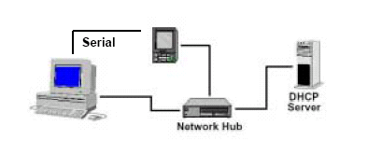
Configure network for Ethernet
Using network hub

Slide 56
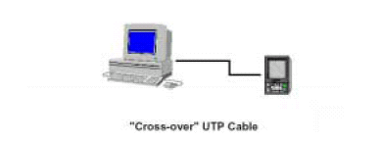
Configure network for Ethernet
Using an isolated network

Slide 57
Configure Serial debug port
Plug the RS232 serial adapter into the ADS board default serial debugport to the Com port on your workstation.
Activate a Hyperterm window by choosing Start Menu → Programs→ Accessories → Hyperterminal → Hyperterminal.

Slide 58
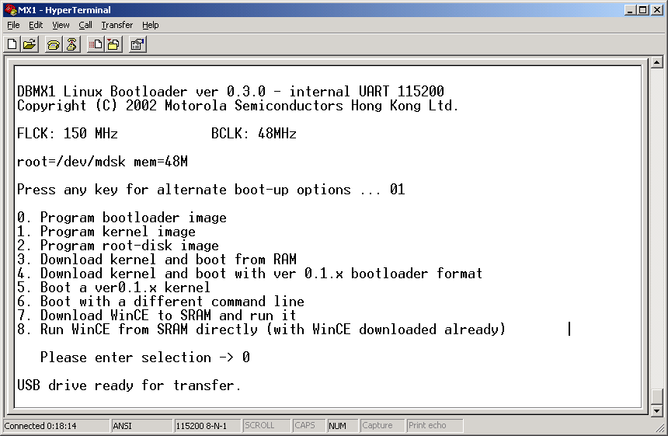
Hyperterminal

Slide 59
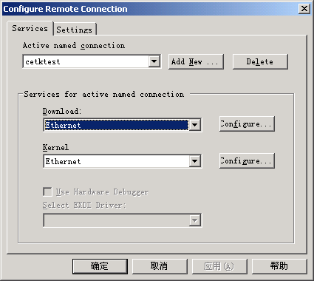
Configure PB connection
From Target -> Configure Remote Connection

Slide 60
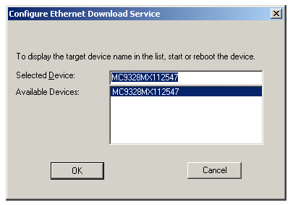
Configure PB connection
Eboot will send broadcast package to LAN, Platform Builder receive the message and display the device ID.

Slide 61
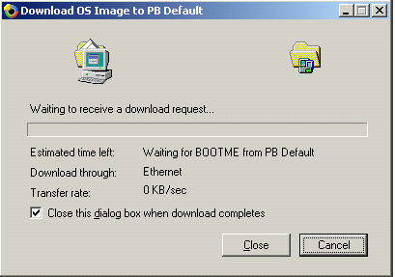
Download OS image to Board
From PB, click on Target → Download/Initialize.

Slide 62
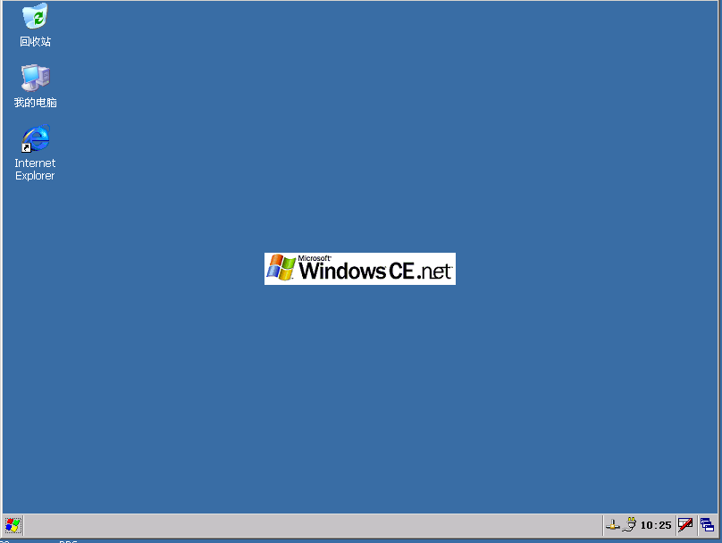
You should be able to see this screen on device

Slide 63
Where are we?
Get hardware & BSP from OEMs
Need platform customization?
Customize your Win CE platform
Get platform & SDK from OEMs
Export your SDK
Coding & Testing
Release to Manufacture

Slide 64
Agenda
Introduction to Platform Builder
  User Interface
  Catalog and Feature
  Platform Configuration
Platform Creation workflow
The Build System
Catalog Customization

Slide 65
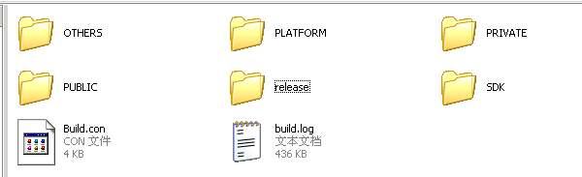
PB Directory Structure
Directory | Description
Others | Run-time files, binary files for building OS image files, registry files, and batch files that are used to add files to an OS image.
Platform | BSP and Device-specific files and directories.
Private | Source code for the Windows CE OS.
Public | Directories for the Windows CE OS configurations.
SDK | Tools and libraries in the Windows CE SDK that support Platform Builder.

Slide 66
Environment Variables
%_WINCEROOT% - Root of the Windows CE build install
Typically C:\WINCE500
%_PUBLICROOT% - %_WINCEROOT%\PUBLIC
%_PLATROOT% - %_WINCEROOT%\Platform
Many others
  Use ‘set’ in a command prompt build window to see a list of the environment variables currently set.

Slide 67
The Platform Directory
Contains Hardware Platform-specific BSP files
Is located at the path %_WINCEROOT%\Platform
Contains subdirectories
  Each subdirectory represents a Windows CE–specific platform adaptation
  Each directory contains a dirs file and one or more batch files for unique BSP settings
Place your Hardware Platform-specific files in this directory

Slide 68
The Public Directory
Contains a platform-independent set of components and configurations
Is located at the path %_WINCEROOT%\Public
Contains subdirectories:
  Module and component subdirectories- Common, Wceshellfe, Wceappsfe, IE, Servers
  Reference configuration subdirectory- CEBASE

Slide 69
The SDK Directory
Is located at the path %_WINCEROOT%\SDK
Contains tools to support Platform Builder
  Processor compilers
  Development tools
  Miscellaneous utilities

Slide 70
The Others Directory
Is located at the path %_WINCEROOT%\OTHERS
Contains subdirectories:
  ATL: Contains ATL headers, libraries and source code for debugging
  DOTNET: Contains the .NET processor specific binaries and portable .NET Compact Framework files
  MFC: Contains MFC Headers, Libraries and Source Code for debugging
  SAMPLES: Contains the MFC and ATL sample applications
  WCETK: Contains the Windows CE Test Kit (CETK) processor specific binaries

Slide 71
The Private Directory
Is located at the path %_WINCEROOT%\PRIVATE
Must check option at installation time and agree to Shared Source License terms
  You can ship modified versions of the private code with your product!
Premium (“Almost everything”) Source available
Contains source code for:
  Kernel
  GWES components
  Filesys components

Slide 72
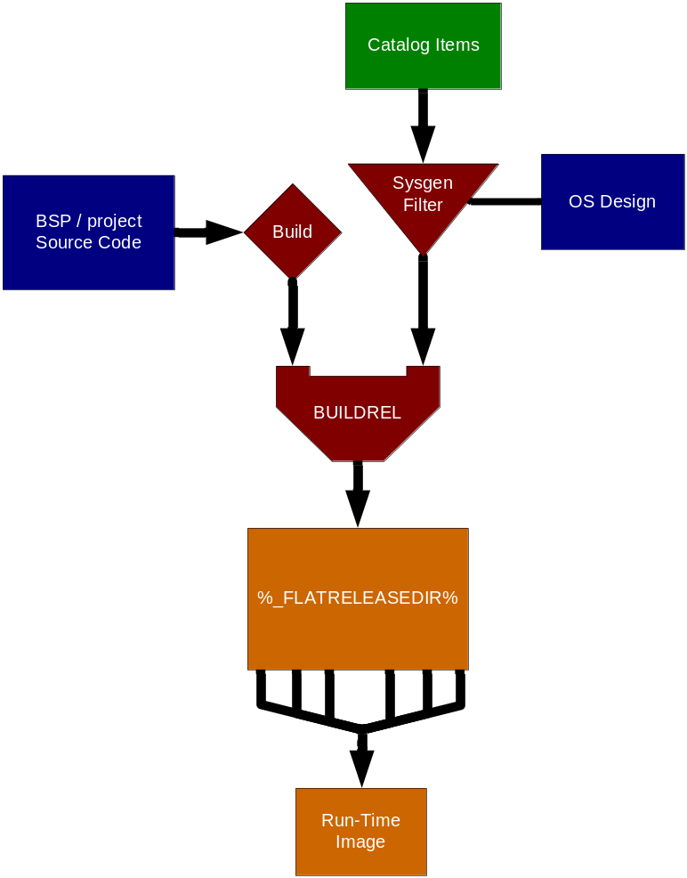
Review of 4 build steps
SYSGEN
  Filters modules and components based on OS Design settings
Build
  Uses DIRS, SOURCES and OS Design Workspace to build Source Code for the BSP and applications
BUILDREL
  Copies files into the Flat Release Directory
Make Image
  Generates the OS Run-Time Image from the files in the Flat Release Directory
1
1
2
2
3
3
4
4

Slide 73
Overview of Build System
The IDE is a thin client over the command-line tools that make up the build system.
Command line tools use Environment Variables to identify the Build setting and call the compiler & linker
Command line utilities stored at :
  %_PUBLICROOT%\COMMON\OAK\MISC

Slide 74
Environment variables
Important directories
  %_WINCEROOT%
  %_PublicRoot%
Selected OS feature
  SYSGEN_AYGSHELL
  SYSGEN_BATTERY
  SYSGEN_STANDARDSHELL
Platform->Setting options
  IMGAUTOFLUSH
  WINCESHIP
  IMGRAM64

Slide 75
Source code configuration
DIRS
SOURCES
MakeFile
  makefile.def

Slide 76
DIRS Files
DIRS
  Like a “Workspace” contains a list of “projects”
  Text file that lists directories containing other DIRS or SOURCES files
  BUILD.EXE will read the contents of DIRS files to determine what to build
  Example:
DIRS=\
Eboot \
Drivers

Slide 77
SOURCES
SOURCES
  List of source code files for the project
TARGETNAME
  Name of output target (without extension)
TARGETTYPE
  PROGRAM – (.EXE) Application
  DYNLINK – (.DLL) Dynamic Link Library
  LIBRARY – (.LIB) Static library

Slide 78
File organization
Text file that is included into makefile.def to provide target specific information to the build
%_MAKEENVROOT%
MAKEFILE.INC
Local project folder
MAKEFILE.DEF
SOURCES

Slide 79
Useful Command line tools
Wince.bat
Blddemo.bat
Cebuild.bat
Build.exe
Sysgen.bat
Buildrel.bat
Makeimg.exe

Slide 80
Wince.bat
Prepares the development workstation build environment by using three input parameters
  %_TGTCPU%
  %_TGTPROJ%
  %_TGTPLAT%
Ex: wince x86 MYPROJ CEPC

Slide 81
BldDemo.bat
Used to build and create an OS image.
It calls the three tools:
  Cebuild.bat: Builds modules, features, and source code for a platform.
  Buildrel.bat: Copies the files for a platform to a release directory.Make Binary Image tool
  Makeimg.exe Generates an OS image.

Slide 82
Build.exe
Application to traverse directory structure and build multiple items
  Directory structure defined by DIRS files
Provides automatic dependency checking for source files and include files
Central build engine of Windows CE
Calls NMAKE.EXE to do the actual build
DIRS and SOURCES determine what to build

Slide 83
How to set up command line build Environment
Set environment variable
Build the OS image

Slide 84
Sample build
set _WINCEROOT=E:\WINCE420
set _PROJECTROOT=E:\GOOD\WINCE420\Emulator
set _FLATRELEASEDIR=E:\GOOD\RelDir\EMULATOR_X86Release
set _PROJPUBLICROOT=E:\GOOD\WINCE420\public
cd %_WINCEROOT%\public\common\oak\misc
call wince.bat X86 GOOD EMULATOR
set SYSGEN_CURSOR=1
set SYSGEN_CONNMC=1
set SYSGEN_MENU_OVERLAP=1
set SYSGEN_MSIM=1
blddemo –q

Slide 85
Agenda
Introduction to Platform Builder
  User Interface
  Catalog and Feature
  Platform Configuration
Platform Creation workflow
The Build System
Catalog Customization

Slide 86
Windows CE Catalog
Database of CE Catalog items
  Each item is either a module or component of a module that you can select to include in the run-time image
Catalog view shows Catalog items in hierarchical tree
  Allows drag and drop selection of Catalog items to customize the OS design
Extensible by end user and third parties
  Importing CEC files add items to the Catalog

Slide 87
CEC File
  CECInfo block
    Contains general information about the contents CEC file
  ComponentType block
    Describes a top-level organizational description. For example, ‘Audio Driver’ might be a ComponentType (Like a class in OO programming)
  Implementation block
    Describes one specific implementation of a ComponentType (Like an object instance in OO programming)
  BuildMethod block
    Describes where source code for the item is located

Slide 88
Introduction to CEC editor
The CEC Editor is a tool, accessed from the Tools menu, with which you can create and edit .cec files.

Slide 89
Customize CEC file steps:
Creating a Catalog Feature File
Adding an Implementation
Adding a Build Method
Adding BIB Information
Adding the Feature to the Catalog

